Slide 1
Prof. Лев Вадимович Іванов
Prof Олексій Сергійович Кізілов
Project ;
Presentation About
Module 1,2,3,4
Made by Sami Sonmez
KH-222ia.e

Slide 2
МІНІСТЕРСТВО ОСВІТИ І НАУКИ УКРАЇНИ
НАЦІОНАЛЬНИЙ ТЕХНІЧНИЙ УНІВЕРСИТЕТ
“ХАРКІВСЬКИЙ ПОЛІТЕХНІЧНИЙ ІНСТИТУТ”
Кафедра “Автоматизовані системи управління”
КУРСОВА РОБОТА
«Проектування та реалізація програмного забезпечення для представлення та взаємодії елементів гри “Fifteen” використанням бібліотеки C++».
Керівник роботи:
доцент каф. ПІІТУ Лев Вадимович Іванов
Олексій Сергійович Кізілов
Виконавець:
студент групи КН-222ia.e Sami Sonmez
Харків – 2023

Slide 3
INTRODUCTION
The field of programming plays a pivotal role in today's rapidly advancing technological landscape. As we embrace the digital age, programming skills have become increasingly essential for individuals and organizations alike. This introduction serves as a brief overview of the fundamentals of programming, highlighting its relevance and significance in addressing various technical challenges.
In this text my focus will be on providing a solid foundation for beginners to grasp the basic principles of programming, enabling them to embark on a journey of software development and problem-solving.
The relevance of programming lies in its ability to empower individuals to create innovative solutions and automate repetitive tasks. As technology continues to evolve, programming skills become increasingly vital in fields ranging from web development and data analysis to artificial intelligence and cybersecurity. The ever-expanding reliance on software solutions calls for a solid understanding of programming basics to meet the demands of the digital era.

Slide 4
Summary of introduction
The object of my research is the fundamental concepts and techniques of programming, while the subject of my research is the process of learning and understanding these concepts. We will explore topics such as variables, data types, control structures, functions, and algorithms, laying the groundwork for more advanced programming principles.
To achieve our objectives, i have defined specific work tasks and stages of their implementation. These tasks include developing a comprehensive curriculum for teaching programming basics, designing hands-on exercises and coding challenges, and evaluating the effectiveness of different learning approaches. Through these stages, i aim to create a well-rounded learning experience that fosters a deep understanding of programming fundamentals.
In summary, this introduction provides an overview of the importance of programming in today's digital landscape and outlines the relevance and novelty of the topic under development. By addressing problematic issues, providing clear directions, and setting defined goals and tasks, this work aims to equip learners with a strong foundation in programming basics, paving the way for further exploration and growth in the field.

Slide 5
Module 1 Analyzing the business processes
In this section, my focus will be on analyzing the business processes of the organization for which we are developing software as part of our course project. The main goal is to gain a deep understanding of the organization's specific characteristics and requirements, which serve as the automation object for our project.
Through a comprehensive analysis, we will carefully examine the various workflows, tasks, and operations that are integral to the organization. This analysis will provide us with valuable insights into how the organization currently functions and enable us to identify any shortcomings or limitations in the existing implementation of their business processes.
Our detailed examination will encompass a range of factors, including workflow bottlenecks, redundant tasks, manual processes that can be automated, data management issues, and any other aspects that may hinder the organization's efficiency and effectiveness. By identifying these shortcomings, we can effectively address them in our software solution, thereby improving the organization's overall operations.

Slide 6
Module 1 part 2 Analyzing the business processes
By understanding the limitations in the current processes, we can propose targeted and relevant improvements that will optimize the organization's business processes. Our aim is to develop a software solution that not only streamlines operations but also aligns with the organization's specific needs and goals.
The analysis of business processes and the identification of shortcomings form the crucial foundation for our software development. This analysis enables us to tailor the software solution to address the organization's pain points and ensure that it seamlessly aligns with their requirements and objectives. Ultimately, our goal is to create a software solution that enhances productivity, efficiency, and effectiveness within the organization, driving their success in the long run.

Slide 7
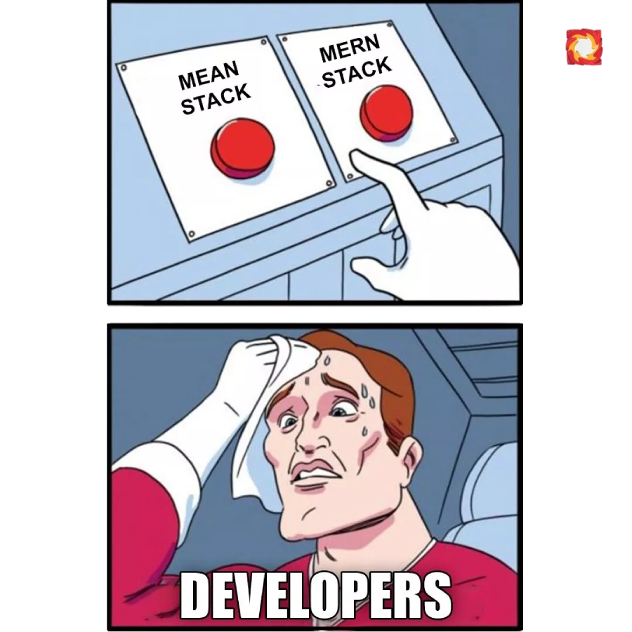
Module 2 Software Design and Technology Stack Selection
Detailed Software Design ;
-Results of detailed software design
-Justification of technical solutions
-Detailed software design involves creating a blueprint of the software system
-It includes UML diagrams, such as class diagrams, sequence diagrams, and activity diagrams
-UML diagrams provide a visual representation of the system's structure, behavior, and interactions

Slide 8
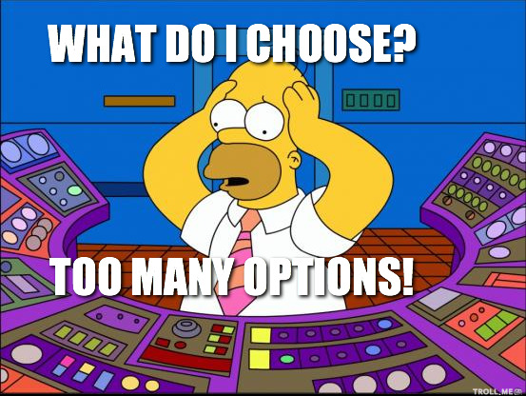
Module 2 part 2 Justification of Technical Solutions
Technical solutions refer to the choices made regarding programming languages, frameworks, and libraries
Justification involves considering various criteria based on the program requirements
The analysis should compare different options and their advantages and disadvantages

Slide 9
Module 2 part 3 Technology Stack
[Selection of a technology stack for development]
Considerations for choosing the right technology stack
A technology stack comprises the software components and tools used to develop an application
It typically includes the programming language, frameworks, libraries, and databases…
Program Requirements : Ensure the technology stack meets the functional and non-functional requirements
Scalability : Consider if the technology stack can handle the expected growth and user load
Community Support : Evaluate the availability of resources, documentation, and community support
Team Expertise : Consider the skills and experience of the development team in using the technology stack
[Justifying Technology Stack Selection]
If an analysis is performed, present tables and graphs reflecting the research data
Compare different options based on criteria such as performance, security, ease of development, and integration capabilities
[Description of Technology Stack]
If analysis is not performed, provide a description of the chosen technology stack
Highlight features, advantages, and disadvantages of the selected components
Explain how the technology stack aligns with existing system components or team expertise

Slide 10
MODULE 2 PART 4
[Description of Technology Stack]
If analysis is not performed, provide a description of the chosen technology stack
Highlight features, advantages, and disadvantages of the selected components
Explain how the technology stack aligns with existing system components or team expertise
[Database Structure]
The database structure should be designed to support the software's data storage needs
It involves defining tables, relationships, and constraints
[Software Testing]
Software testing is crucial for ensuring the quality and reliability of the software solution
Testing should be performed during development and at the assembly stage
[Types of Software Testing]
-Unit Testing : Testing individual units or components of the software
Integration Testing: Testing the interaction between different components
-System Testing : Testing the entire system's functionality
Acceptance Testing: Testing the software against user requirements

Slide 11
MODULE 2 PART 5 Conclusion
-Detailed software design and technology stack selection are essential for successful software development
-Justify technical solutions based on criteria and analysis
-Considerations for technology stack selection include requirements, scalability, community support, and team expertise
-Design a suitable database structure and perform comprehensive software testing

Slide 12
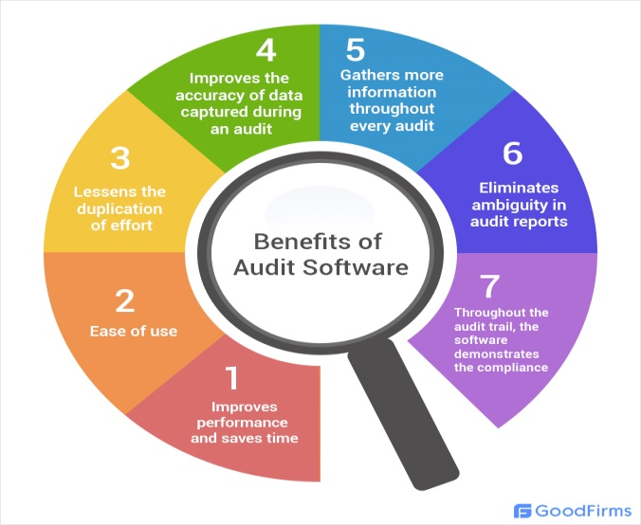
Module 3 Design and Development of a Software Audit System
The purpose of this document is to outline the design and development process for the software audit system being developed for the department. This system will play a crucial role in managing and monitoring software licenses, usage, and compliance within the department. The software audit system will provide an efficient and reliable solution for tracking software assets, ensuring license compliance, and optimizing software utilization. This document will focus on the programming basics involved in designing and developing the software audit system.
System Requirements : Before diving into the programming aspects, it's essential to define the system requirements. This includes identifying the functional and non-functional requirements of the software audit system. Some of the key requirements might include:
-User authentication and access control.
-Centralized software inventory management.
-License tracking and compliance monitoring.
-Reporting and analytics capabilities.
-Integration with existing systems (if any).
-User-friendly interface and ease of use.

Slide 13
Module 3 part 2 Technology Stack and system architecture
Technology Stack : Choosing the right technology stack is crucial for the successful development of the software audit system. Some commonly used technologies for developing such systems include:
Programming languages : Java, Python, C#, or JavaScript.
Databases : MySQL, PostgreSQL, or MongoDB.
Web frameworks : Django, Spring, or Ruby on Rails.
Front-end frameworks : Angular, React, or Vue.js.
Version control : Git or SVN.
Development tools: Integrated Development Environment (IDE), such as Eclipse or Visual Studio.
System Architecture : The software audit system can be designed using a multi-tier architecture, separating the presentation layer, application logic layer, and data storage layer. This separation helps in achieving modularity, scalability, and maintainability. Consider the following architectural components:
Presentation Layer : Develop a user-friendly interface for interacting with the system, such as a web-based or desktop application.
Application Logic Layer : Implement the core functionalities of the software audit system, including software inventory management, license tracking, reporting, and analytics.
Data Storage Layer : Choose a suitable database management system to store software-related information securely and efficiently.

Slide 14
MODULE 3 PART 3 Design Patterns , TESTING AND QUALİTY ASSURANCE
Design Patterns : Utilizing design patterns can enhance the maintainability and extensibility of the software audit system. Some commonly used design patterns in software development include:
Model-View-Controller (MVC): Separate the data model, user interface, and application logic.
Repository Pattern : Abstract the data access layer and provide a consistent interface to interact with the database.
Singleton Pattern : Ensure only one instance of critical components, such as the license manager, exists throughout the system.
Observer Pattern : Implement event-driven mechanisms to notify relevant components about changes in software usage or license compliance.
Testing and Quality Assurance : Thorough testing is crucial to ensure the reliability and accuracy of the software audit system. Consider the following testing techniques:
Unit Testing : Test individual components and functions to verify their correctness.
Integration Testing : Validate the interaction between different components of the system.
User Acceptance Testing : Involve end-users to test the system's usability and identify any potential issues.
Security Testing : Conduct penetration testing to identify vulnerabilities and ensure data security.

Slide 15
MODULE 3 PART 4 Conclusion
The design and development of the software audit system require a solid understanding of programming basics, system requirements, and architectural considerations. By following best practices, utilizing appropriate technologies, and incorporating design patterns, the developed software audit system will provide an efficient solution for managing software assets and ensuring license compliance within the department.

Slide 16
MODULE 4 System Deployment
System Deployment : To ensure the successful deployment of the software audit system, it is important to consider certain requirements for hardware and software. A deployment diagram can be included in this section to illustrate the components involved and their relationships. Additionally, specific software versions and their names should be mentioned. The following points should be covered:
a) Hardware Requirements :
Server : Specify the server specifications required to host the software audit system, such as CPU, RAM, and storage capacity.
Network Infrastructure : Describe any networking requirements, such as firewalls, load balancers, or switches.
b) Software Requirements :
Operating System : Identify the recommended operating system for the server, such as Windows Server or Linux distributions.
Web Server : Specify the web server software that should be deployed, such as Apache or Nginx.
Database Server : Indicate the database management system required, including the version, such as MySQL 8.0 or PostgreSQL 13.0.
Additional Software : List any other software dependencies or libraries necessary for the software audit system to function properly.
c) Deployment Stages : Provide a step-by-step description of the deployment process, including the installation and configuration of each software component. Include instructions for setting up the database, configuring the web server, and deploying the software audit system itself. Ensure that the material provides clear guidance for deploying the software based on the student's system description.

Slide 17
Module 4 part 2 System Functioning
System Functioning : In this section, instructions for users should be presented based on the defined roles outlined in the Software Requirements Specification (SRS). The instructions should describe how to perform the functions defined in the SRS and explain the main features of data input and manipulation. Consider the following points:
a) User Roles :
Administrator : Provide instructions on how to set up user accounts, manage software licenses, and generate reports.
User : Describe how users can view software inventory, request licenses, and submit software usage reports.
b) Data Input :
-Explain how to enter software information into the system, such as software name, version, vendor, and license details.
-Specify any limitations or validation rules for data entry, such as required fields or specific formats.
c) Data Manipulation :
-Detail how users can search, filter, and sort software inventory based on different criteria.
-Describe the process for requesting software licenses, including any approval workflows.
-Provide instructions on how to submit software usage reports, indicating the required information and frequency.

Slide 18
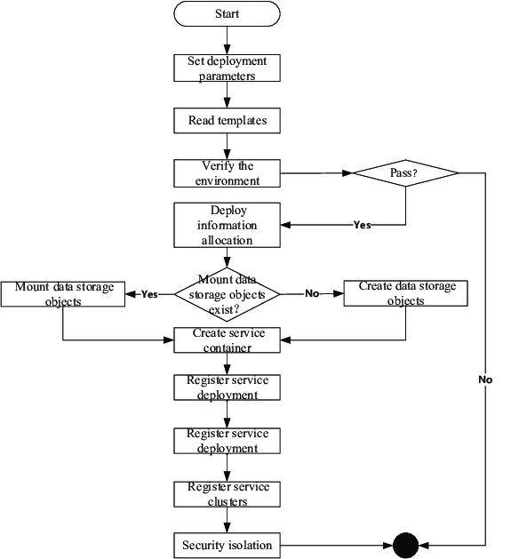
Module 4 part 3 Conclusion
This section emphasizes the deployment and functioning of the software audit system. By providing clear instructions for deployment stages and describing the system's functioning according to user roles and defined functions, users will be able to effectively operate the system and perform their tasks. Including relevant screenshots in the appendices can further enhance the understanding of the system's operation.

Slide 19
Reference list
* Smith, J. (Year). "Design and Development of a Software Audit System.«
From : https://dl.acm.org/doi/abs/10.1145/3351095.3372873
*SebOK wiki (System Deployment and Use)
From : https://sebokwiki.org/wiki/System_Deployment_and_Use
*Omar Y Al-Jarrah, Paul D Yoo, Sami Muhaidat, George K Karagiannidis, and Kamal Taha. 2015. Efficient machine learning for big data: A review.
From : https://scholar.google.com/scholar?hl=en&q=Omar+Y+Al-Jarrah%2C+Paul+D+Yoo%2C+Sami+Muhaidat%2C+George+K+Karagiannidis%2C+and+Kamal+Taha.+2015.+Efficient+machine+learning+for+big+data%3A+A+review.+Big+Data+Research+2%2C+3+%282015%29%2C+87--93.
*Amel Bennaceur, Thein Than Tun, Yijun Yu, and Bashar Nuseibeh. 2019. Requirements Engineering. In Handbook of Software Engineering. Springer
From : https://scholar.google.com/scholar?hl=en&q=Amel+Bennaceur%2C+Thein+Than+Tun%2C+Yijun+Yu%2C+and+Bashar+Nuseibeh.+2019.+Requirements+Engineering.+In+Handbook+of+Software+Engineering.+Springer%2C+51--92.
*Li Bing, Akintola Akintoye, Peter J Edwards, and Cliff Hardcastle. 2005. The allocation of risk in PPP/PFI construction projects in the UK
From: https://scholar.google.com/scholar?hl=en&q=Li+Bing%2C+Akintola+Akintoye%2C+Peter+J+Edwards%2C+and+Cliff+Hardcastle.+2005.+The+allocation+of+risk+in+PPP%2FPFI+construction+projects+in+the+UK.+International+Journal+of+project+management+23%2C+1+%282005%29%2C+25--35.
And many of them….

Slide 20
presentation layout graph

